Slide 1
Same Words, Different Worlds
AI in the Polarized U.S. Congress
Final Project
For
PPOL 6801: Text as Data
Darren Deng

Slide 2
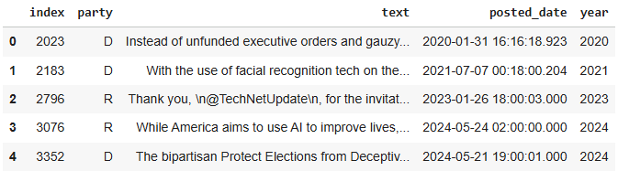
Data Source
https://atlas.nomic.ai/data/hivemind/tweets-from-members-of-us-congress-2023-2024/map
Tweets amount before filter: 1893564
Amount after AI keywords Filter: 3158
Amount after throw ‘Independent’ Party: 3151

Slide 3
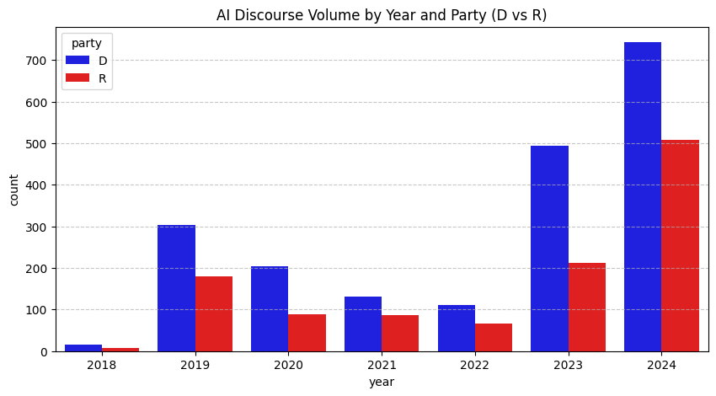
AI Discourse Volume

Slide 4
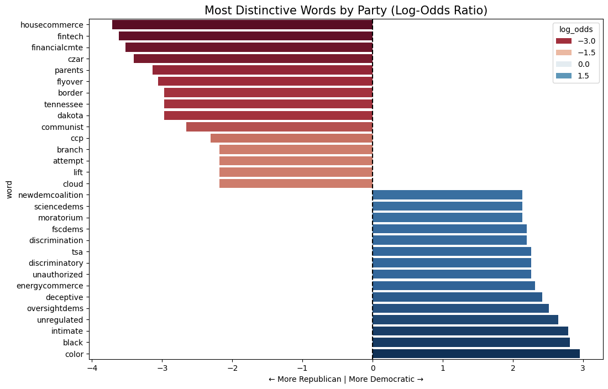
Log-Odds Ratio
Bag of Words Approach
Formula: log( (count_D + 1) / (total_D + 1) ) - log( (count_R + 1) / (total_R + 1) )

Slide 5
Why Embeddings
Why Domain Adaptation ( Fine-tuning)?
Why Roberta-Base?
And how to do that?
And what did we get now?

Slide 6
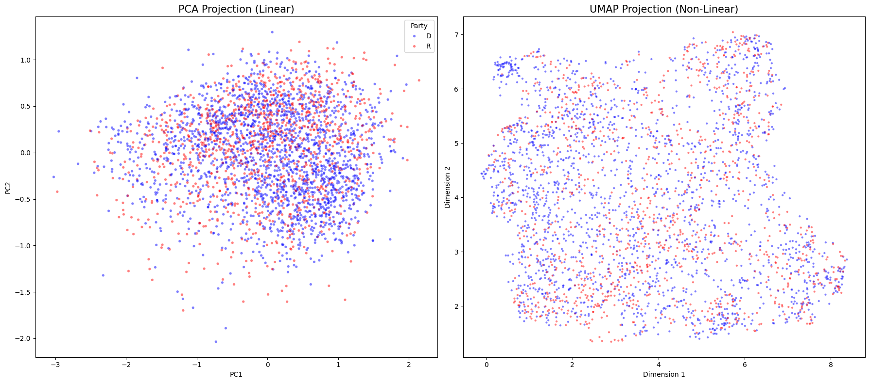
Dimensionality reduction visualization.

Slide 7
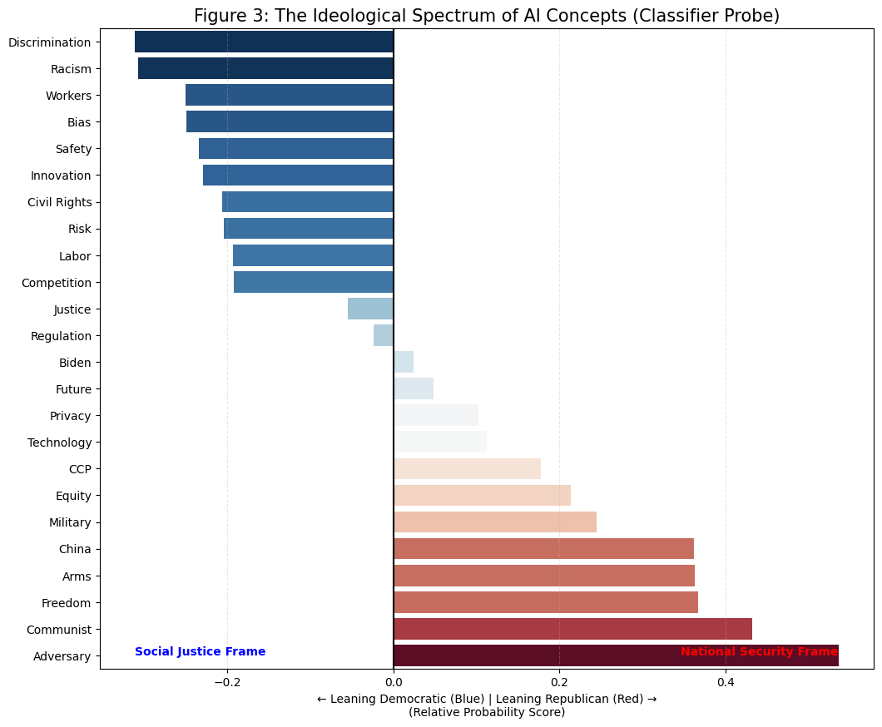
The Classifier Probe

Slide 8
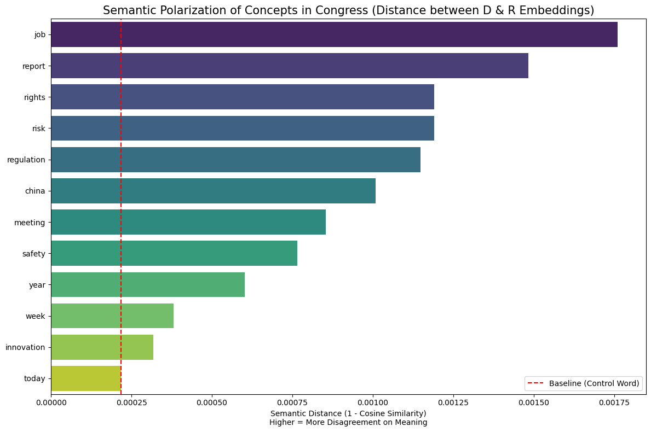
Partisan semantic distance

Slide 9
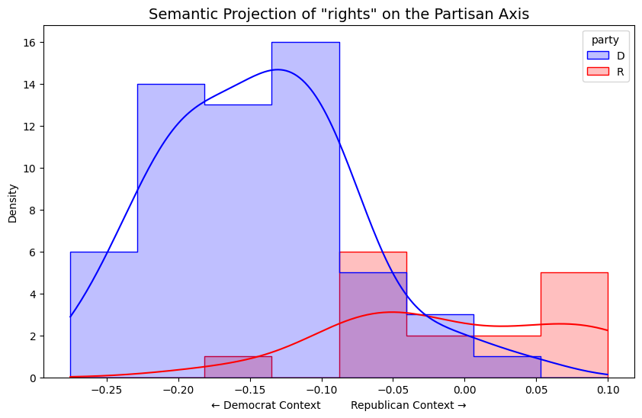
Semantic projection axis

Slide 10
Most 'Republican' usage of rights:
Google refused to work with the U.S. military on artificial intelligence, yet had no problem opening up an AI research center in #China. The authoritarian #CCP uses AI for mass surveillance operations &amp; human rights abuses. Helping China's AI is wrong!
------------------------------
Most 'Democrat' usage of rights:
We know that there are far too many potential biases within AI technologies that could unfairly impact people of color. I am committed to advancing bipartisan legislation that protects all Americans and will protect civil rights in the age of AI.

Slide 11
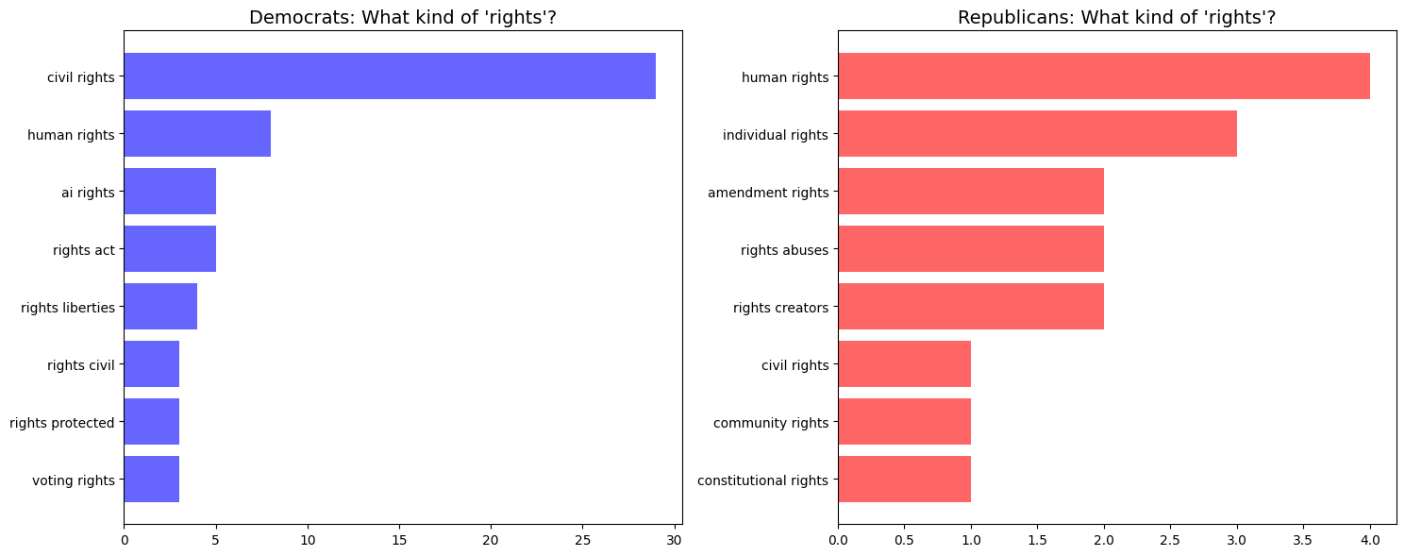
Let’s talk about “Rights”

